Slide 1

Random Variables Expectation and Variance
J. Alejandro Gelves

Slide 2
Objectives
Define a Random Variable (RV)
Define Expected Value and Variance for RV’s
Understand the properties of Expectation, Variance and Covariance
Application Optimal Investment Portfolio

Slide 3
Random Variables
We will see the world as a collection of experiments. The results of the experiments will be captured by a random variable.
A random variable associates a numerical value with each possible experimental outcome.
Mainly, random variables can be a continuous value, an integer or a binary outcome (true/false).

Slide 4
Discrete Random Variables
Experiment | Random Variable (x) | Possible Values
Contact five customers
Number of customers who place an order
0, 1, 2, 3, 4, 5
Operate a restaurant for one day
Number of customers
0, 1, 2, 3, …
Selling a car
Gender of the customer
0 if male; 1 if female

Slide 5



Continuous Random Variables
Experiment | Random Variable (x) | Possible Values
Operate a bank
Time between customer arrivals in minute
$$x≥0$$
Fill a soft drink can
Number of ounces
$$0≤x≤12.1$$
Construct a new library
Percentage of project completed
$$0≤x≤100$$

Slide 6
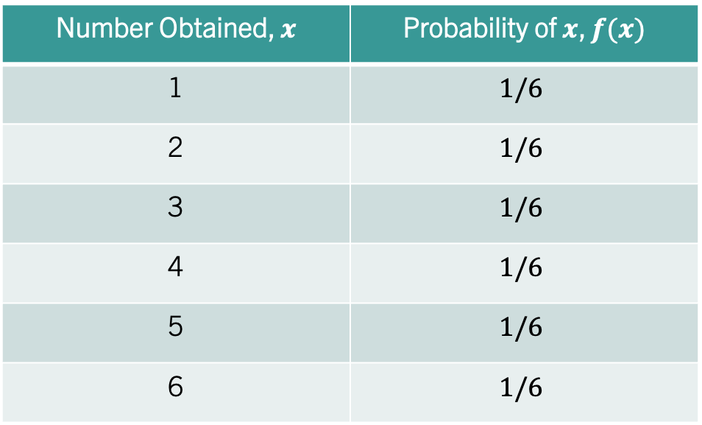
Random Variables
A random variable takes on a value with some probability.
A random variable is fully characterized by its probability density function (PDF) if continuous or the probability mass function (PMF) if discrete.
Number Obtained, $x$ | Probability of $x$, $f(x)$
1 | $$1/6$$
2 | $$1/6$$
3 | $$1/6$$
4 | $$1/6$$
5 | $$1/6$$
6 | $$1/6$$

Slide 7
Random Variables
When summarizing a random variable, we are mostly interested in the variable’s central tendency (mean) and dispersion (variance).
Together, these two summarize the outcomes of an experiment.
When summarizing, information is lost!

Slide 8

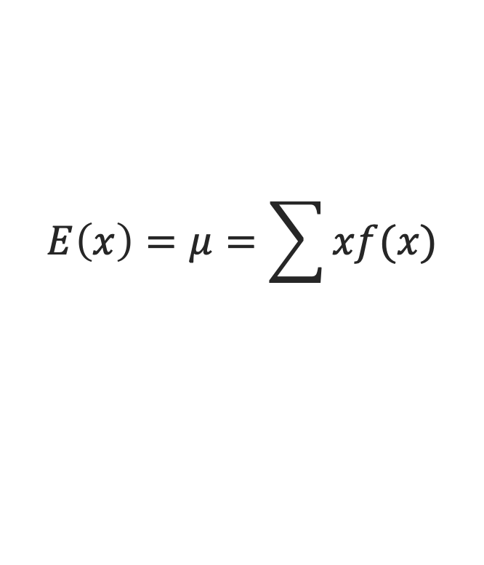
Expected Value
The expected value (mean) is a measure of central location.
where $f(x)$ is the probability mass function.
$$E\left(x\right)=μ=\sum{xf(x)}$$

Slide 9
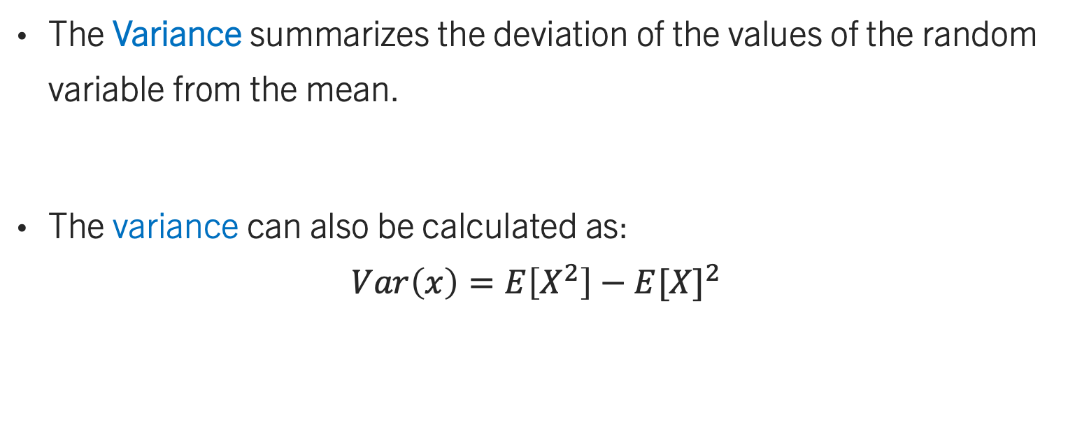
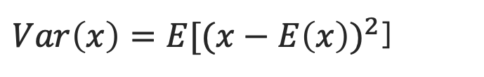
Variance
The Variance summarizes the deviation of the values of the random variable from the mean.
The variance can also be calculated as:
$$Var\left(x\right)=E\left[X^{2}\right]−{E[X]}^{2}$$
$Var\left(x\right)=E[{(x−E\left(x\right))}^{2}$]

Slide 10
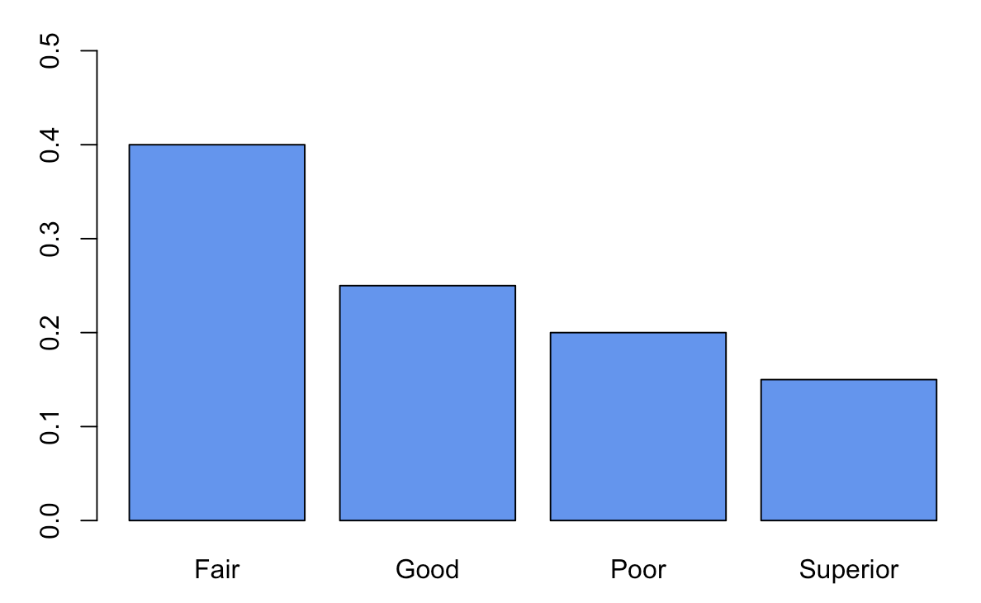



Example I
Consider the following incentive compensation:
$$E\left(x\right)=4.2$$
$$sd\left(x\right)=3.156$$
Bonus in ($1000’s) | Performance Type | Probability
10 | Superior | 0.15
6 | Good | 0.25
3 | Fair | 0.4
0 | Poor | 0.2
$$var\left(x\right)=9.96$$

Slide 11
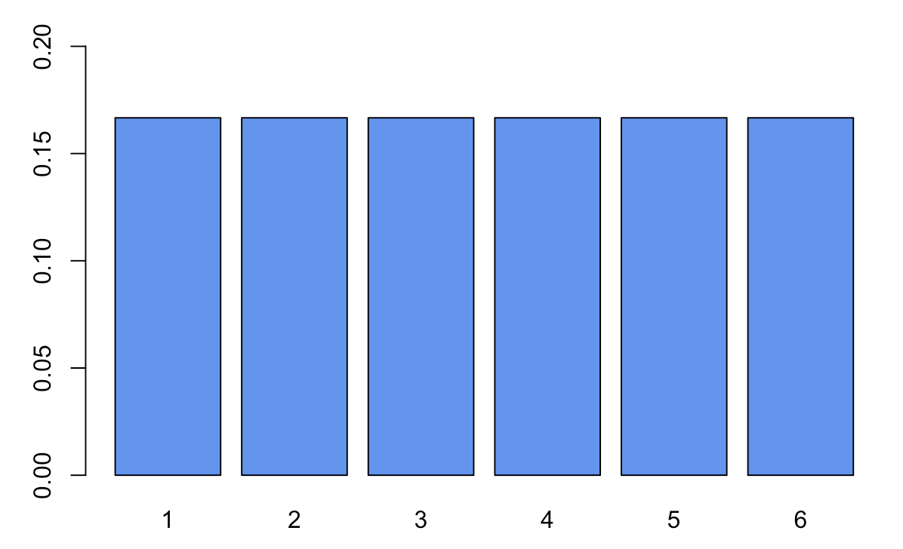


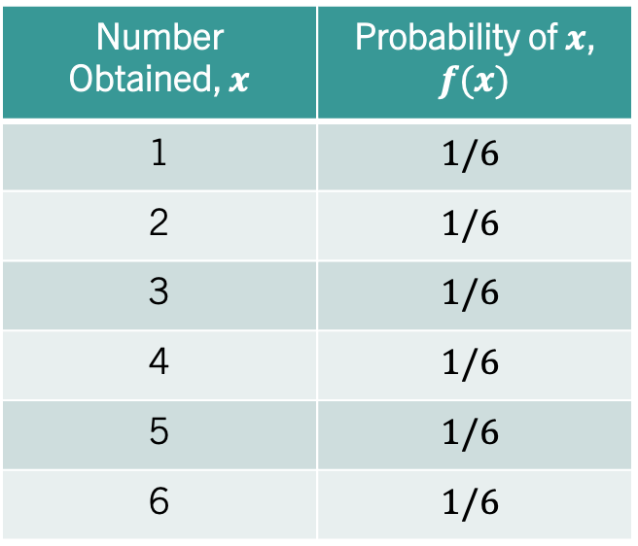

Example II
Tossing a fair die:
Number Obtained, $x$ | Probability of $x$, $f(x)$
1 | $$1/6$$
2 | $$1/6$$
3 | $$1/6$$
4 | $$1/6$$
5 | $$1/6$$
6 | $$1/6$$
$$E\left(x\right)=3.5$$
$$sd\left(x\right)=1.7$$
$$var\left(x\right)=2.92$$

Slide 12






Some Properties of RV’s
Expectation:
Variance:
$$E\left(aX\right)=aE(X)$$
$$Var\left(aX\right)=a^{2}Var(X)$$
$$E\left(aX+b\right)=aE\left(X\right)+b$$
$$Var\left(aX+b\right)=a^{2}Var(X)$$
$$E\left(X+Y\right)=E\left(X\right)+E(Y)$$
$$Var\left(X+Y\right)=Var\left(X\right)+Var\left(Y\right)+2Cov(X,Y)$$
Covariance:
$$Cov\left(aX,bY\right)=abCov(X,Y)$$
Note: If X and Y are independent, then the covariance of X and Y is Zero!

Slide 13








Example III
An Investment Portfolio. 40% / 60%
Period | Bitcoin Annual Returns (x) | S&P Annual Returns (y)
2017 | 13.18 | 0.209
2018 | -0.726 | -0.052
2019 | 0.872 | 0.313
2000 | 3.082 | 0.173
$$E\left(x\right)=4.102$$
$$E\left(y\right)=0.1605$$
$$var\left(x\right)=39.04$$
$$var\left(x\right)=0.024$$
$$cov\left(x,y\right)=39.04$$
$$E\left(0.4x+0.6y\right)=1.74$$
$$Var\left(0.4x+0.6y\right)=6.41$$
$$Sharpe=0.69$$
Notes:
Source: https://www.upmyinterest.com/fund?tick=VOO

Slide 14
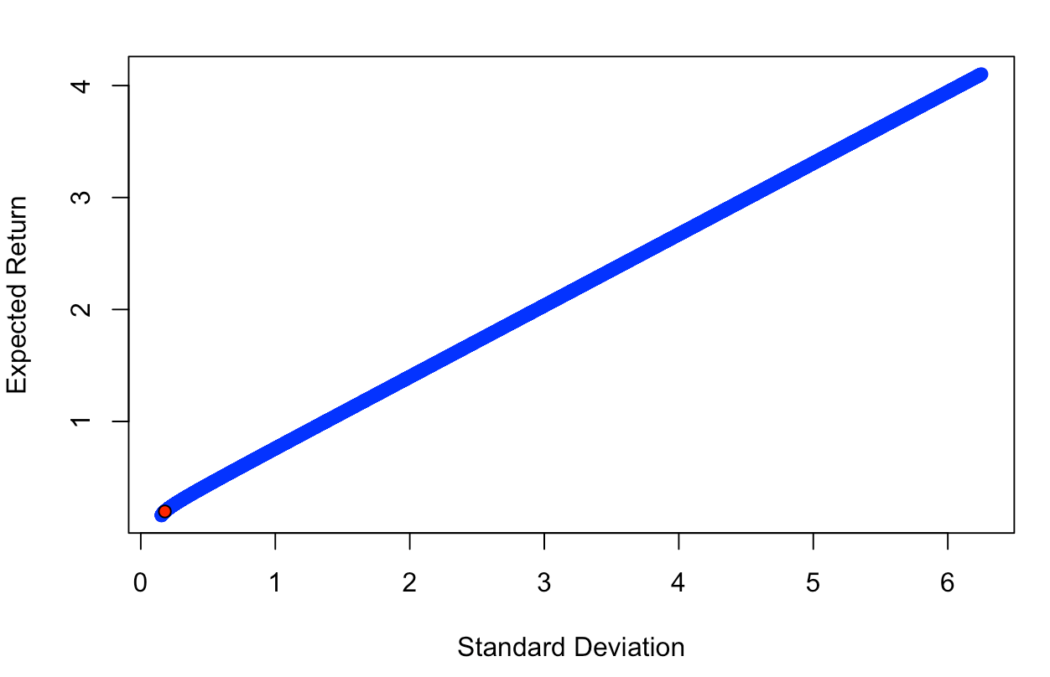




Example III
An Investment Portfolio.
$$Bitcoin 1\%, S\&P 99\%$$
$$E\left(portfolio\right)=0.197$$
$$sd\left(portfolio\right)=0.18$$
$$Sharpe=1.1$$

